Slide 1


Hunter Draizin
4/4/2023

Slide 2

Outline
Executive Summary
Introduction
Methodology
Results
Conclusion
Appendix

Slide 3
Executive Summary
Summary of methodologies
- Web scrapping for vast amounts of usable data
- API for data collection
- Data visualization tools such as Matplotlib
- Data manipulation using Python, SQL and Pandas data frames
- Use of Machine learning for predictions and exploratory analysis.
Summary of all results
- Data visualization using plots and descriptive charts
Final figures from various models
Organized data frame results

Slide 4
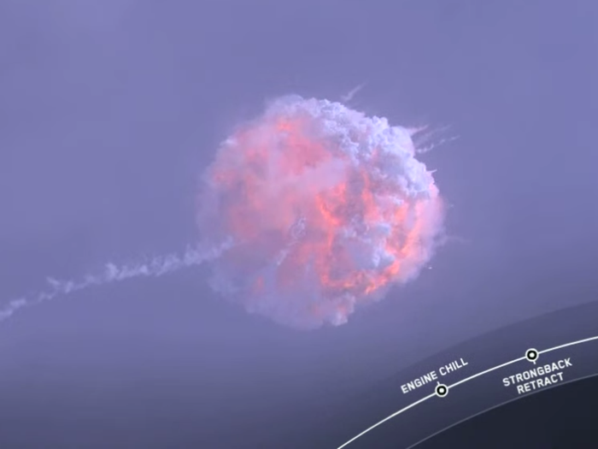
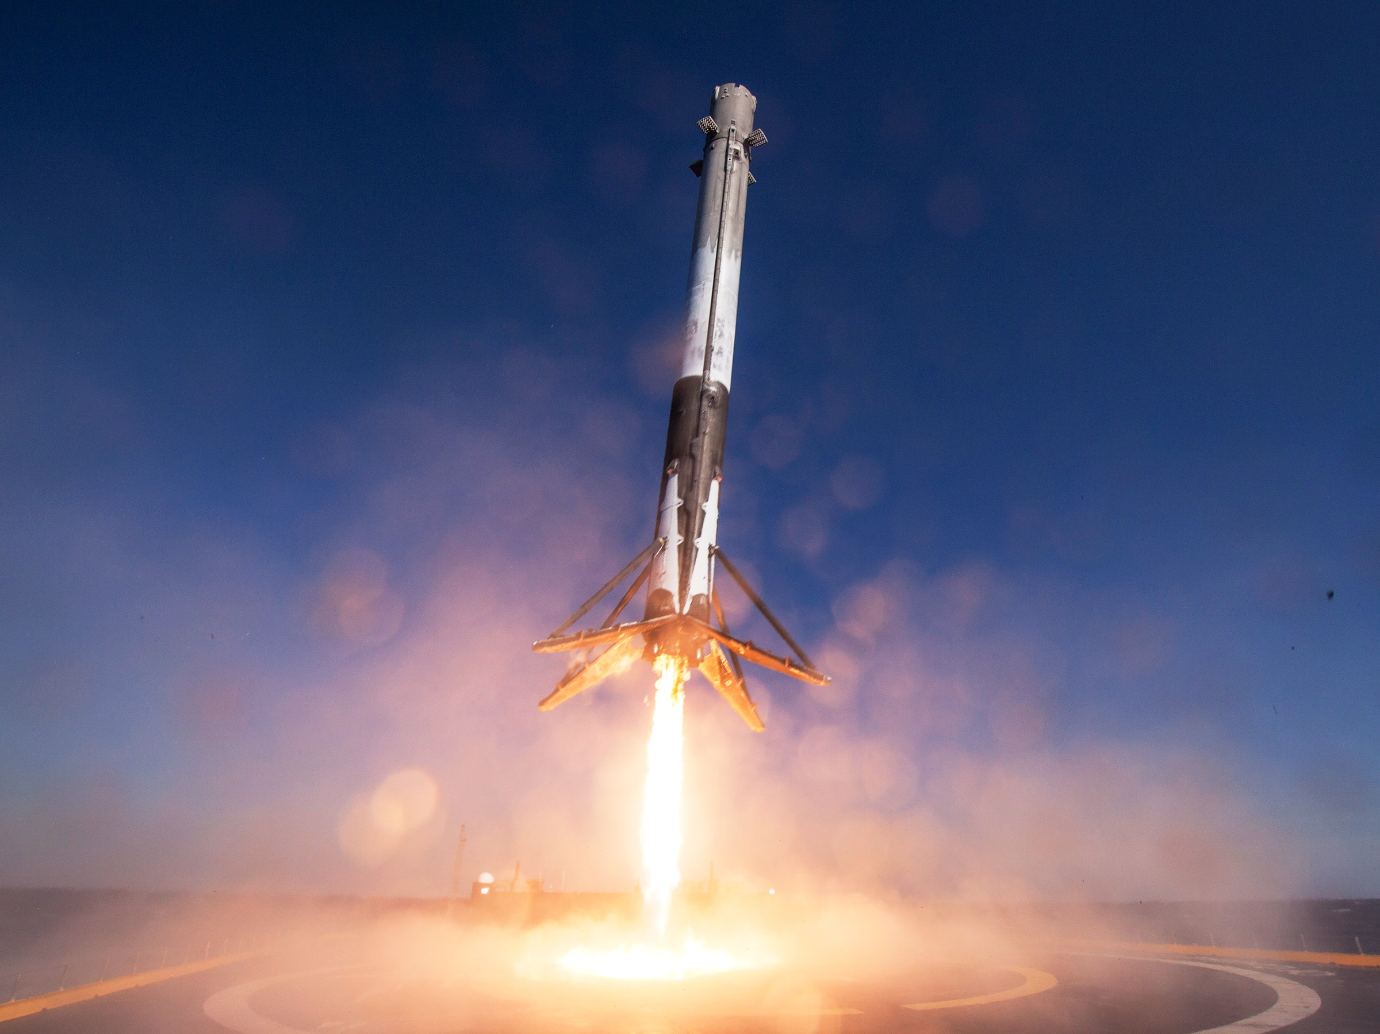
Introduction
SpaceX development of the Falcon 9 rocket is a marvel for the space industry for many reasons, but their flagship ability is cost per a launch. A Falcon 9 rocket can cost 62 million dollars a launch which may sound expensive, but when compared to their alternative or predecessors with similar payload capacity with an average of165 million a launch it’s a steal. The reason for such a price difference is Falcon 9 booster reusability, where the first stage booster returns safely to the earths surface.
If we can determine which sites and conditions produce the highest probability of the booster returning safely, we can calculate the cost of future launches. Follow me threw this project as we explore a machine learning models that can aid use in determining data to help use find our results.

Slide 5

Section 1

Slide 6
Methodology
Executive Summary
Data collection methodology:
Describe how data was collected
Perform data wrangling
Describe how data was processed
Perform exploratory data analysis (EDA) using visualization and SQL
Perform interactive visual analytics using Folium and Plotly Dash
Perform predictive analysis using classification models
How to build, tune, evaluate classification models

Slide 7
Data Collection
The data set was collected by launching an HTTP request which was used to reach the data from the API, then using pandas libraries and numpy for manipulating the data into our desired dimensions to represent the data.
Then we defined a series of helper functions which helped us use the API to extract information using identification numbers in the launch data.

Slide 8
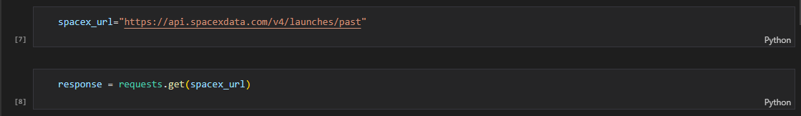
Data Collection – SpaceX API
Here we used the .get method to interact with the spacex_url and begin retrieving launch data.
week 1 jupyter-labs-spacex-data-collection-api.ipynb

Slide 9
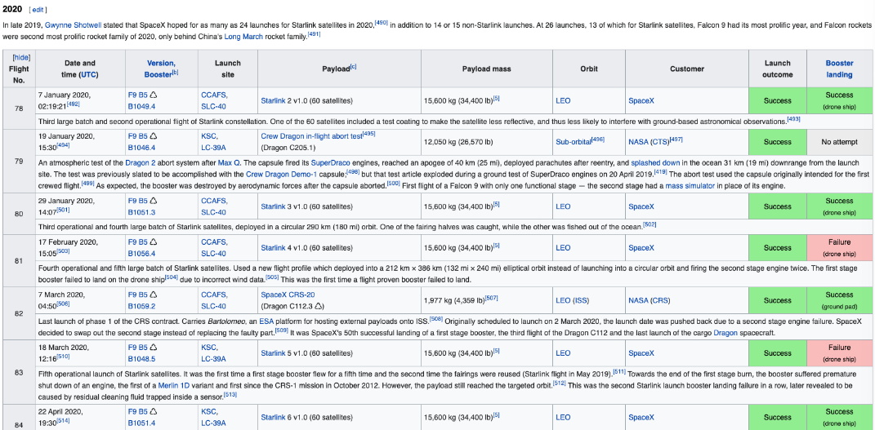
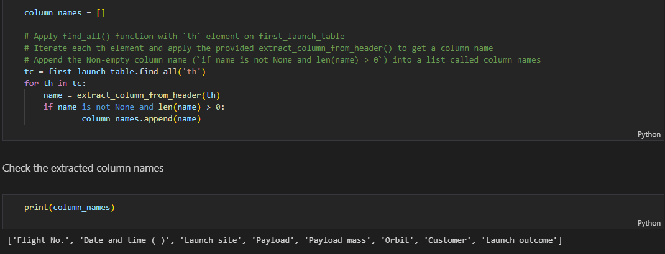
Data Collection - Scraping
We web scraped launch record using the beautifulsoup function to extract records from HTML table on Wikipedia.
We then used helper functions to structure our data.
https://github.com/HunterDraizn/IBM_Datasciance_Capstone/blob/main/week1%20jupyter-labs-%20Space%20X%20Falcon%209%20First%20Stage%20Landing%20Predictionwebscraping.ipynb

Slide 10
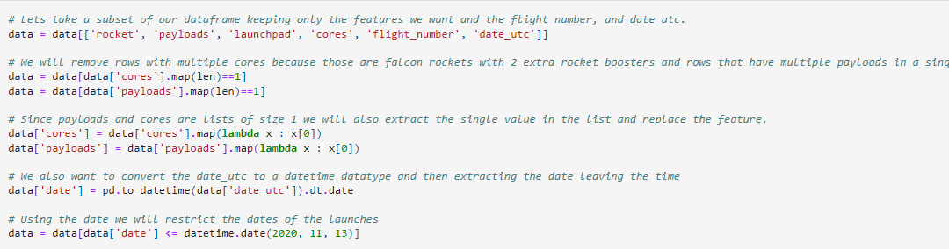
Data Wrangling
We then would retrieve data from our json_url and normalize it into the pandas data frame.
From here we used our API to retrieve information using IDs given for launch.
Lastly, we use the get method coupled with our variables to retrieve the data.

Slide 11
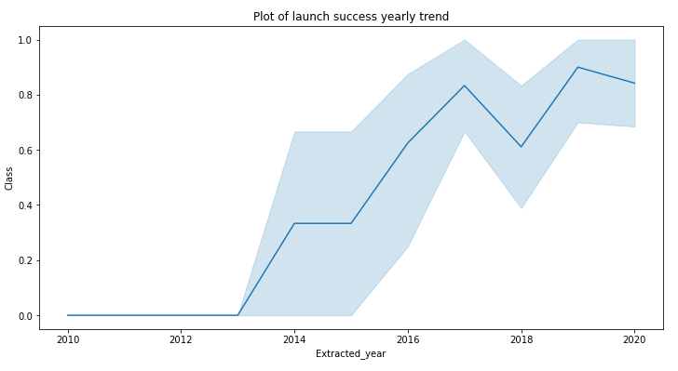
EDA with Data Visualization
This chart depicts the increasing success of the returning booster from the years 2013-2022
https://github.com/HunterDraizn/IBM_Datasciance_Capstone/blob/main/IBM-DS0321EN-SkillsNetwork_labs_module_2_jupyter-labs-eda-dataviz.ipynb.jupyterlite.ipynb

Slide 12
EDA with SQL
Here are some of the SQL quarries used to understand the SpaceX dataset.
Here we imported the dataset from IBMs network-
import pandas as pd
df = pd.read_csv("https://cf-courses-data.s3.us.cloud-object storage.appdomain.cloud/IBM-DS0321EN-SkillsNetwork/labs/module_2/data/Spacex.csv")
df.to_sql("SPACEXTBL", con, if_exists='replace', index=False,method="multi")
Then we loaded the data by viewing launch sites and information like payload mass –
%sql select distinct(LAUNCH_SITE) from SPACEXTBL
%sql select * from SPACEXTBL where LAUNCH_SITE like 'CCA%' limit 5
https://github.com/HunterDraizn/IBM_Datasciance_Capstone/blob/main/jupyter-labs-eda-sql-coursera_sqllite.ipynb

Slide 13
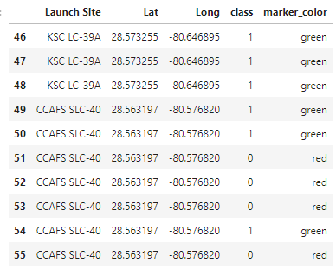
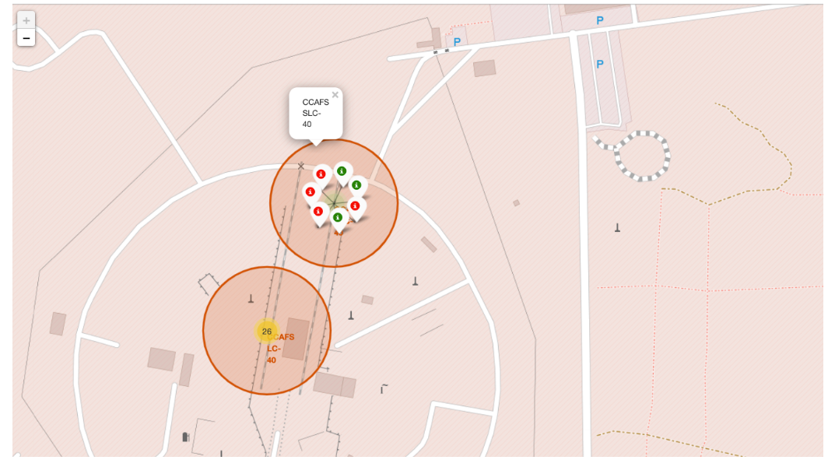
Build an Interactive Map with Folium
Objects such as markers, circles, lines, visually display successful and failed mission sites coupled with their respective sites.
1 or green showing a successful mission
0 or red showing a failed
https://github.com/HunterDraizn/IBM_Datasciance_Capstone/blob/main/IBM-DS0321EN-SkillsNetwork_labs_module_3_lab_jupyter_launch_site_location.jupyterlite.ipynb

Slide 14
Build a Dashboard with Plotly Dash
To further visualize launch site data, we prescribed pie chars and bubble charts to show success rates in comparison to another site.
These visual interactions and dashboard connect the raw data with usable efficient information visualizations.
https://github.com/HunterDraizn/IBM_Datasciance_Capstone/blob/main/IBM-DS0321EN-SkillsNetwork_labs_module_2_jupyter-labs-eda-dataviz.ipynb.jupyterlite.ipynb

Slide 15
Predictive Analysis (Classification)
In this interactive worksheet we demonstrated machine learning techniques to test data sets and fine the most accuracy predictions for predictive analysis.
Using svm and regression modeling for classification we performed test sets and usable set by splitting our data into adequately filled subsets.
Add the GitHub URL of your completed predictive analysis lab, as an external reference and peer-review purpose
https://github.com/HunterDraizn/IBM_Datasciance_Capstone/blob/main/IBM-DS0321EN-SkillsNetwork_labs_module_4_SpaceX_Machine_Learning_Prediction_Part_5.jupyterlite.ipynb

Slide 16
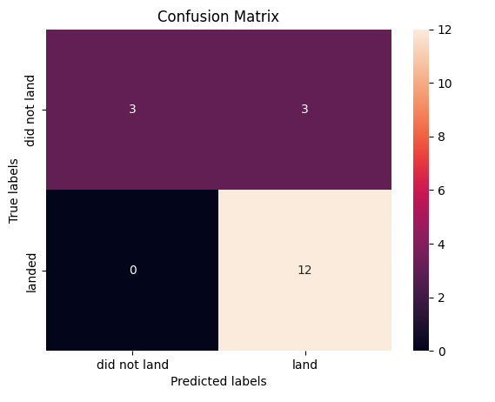
Results
Exploratory data analysis results
Interactive analytics demo in screenshots
Predictive analysis results
We found our GridSearchCV accuracy to be : 0.8482142857142858
knn_cv.score(X_test, Y_test) - 0.8333333333333334

Slide 17

Section 2

Slide 18
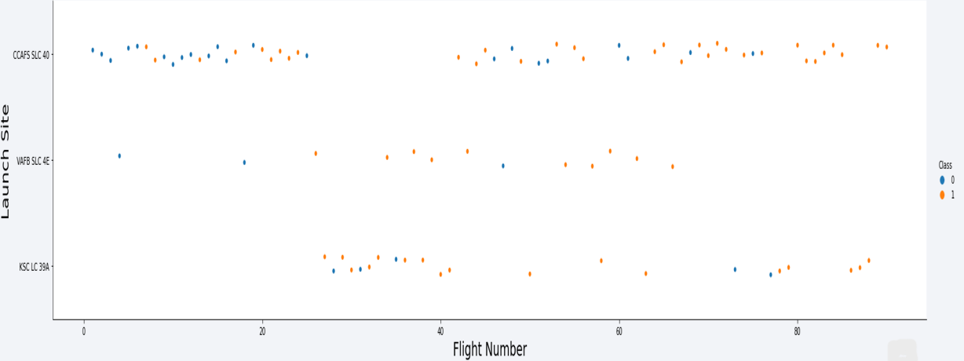
Flight Number vs. Launch Site
Show a scatter plot of Flight Number vs. Launch Site

Slide 19
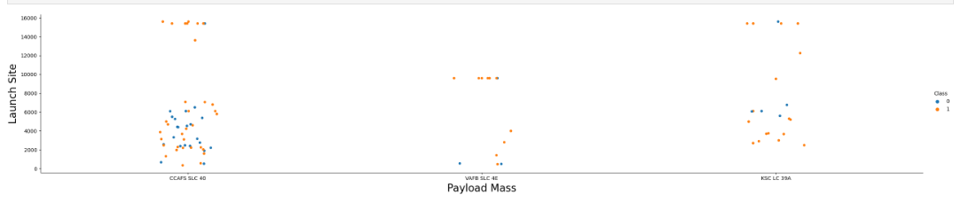
Payload vs. Launch Site
Show a scatter plot of Payload vs. Launch Site

Slide 20
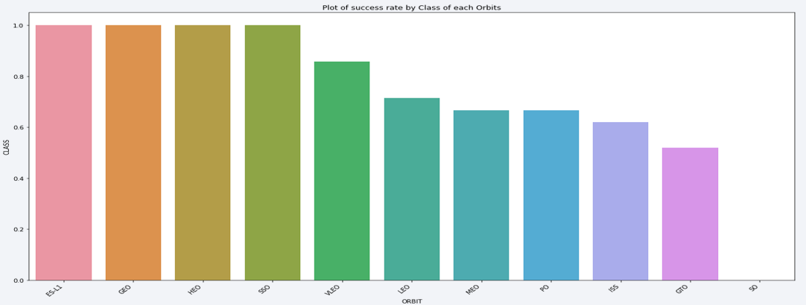
Success Rate vs. Orbit Type
Show a bar chart for the success rate of each orbit type

Slide 21
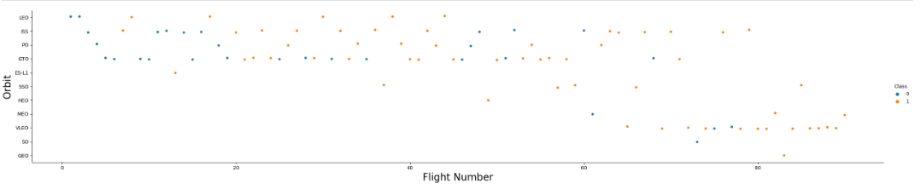
Flight Number vs. Orbit Type
Show a scatter point of Flight number vs. Orbit type

Slide 22
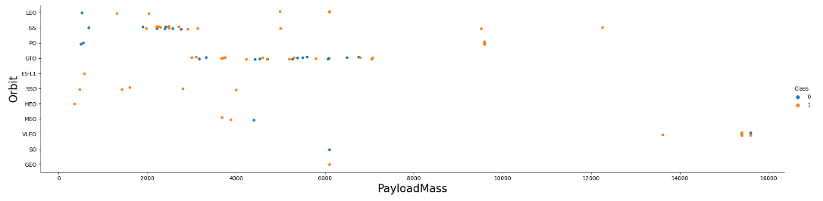
Payload vs. Orbit Type
Show a scatter point of payload vs. orbit type
This shows that LEO and the ISS are at the highest orbit range.

Slide 23
Launch Success Yearly Trend
Show a line chart of yearly average success rate
Increasing launch years from 2013 - 2020

Slide 24
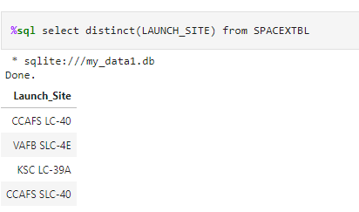
All Launch Site Names
Names of the unique launch sites

Slide 25
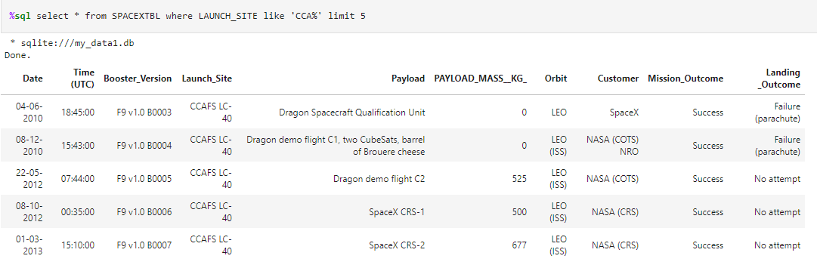
Launch Site Names Begin with 'CCA'
5 `CCA` records showing multiple veriables

Slide 26
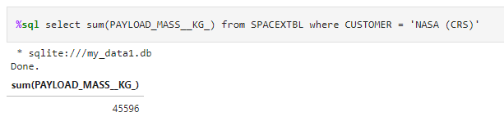
Total Payload Mass
Calculated total payload carried by boosters from NASA

Slide 27
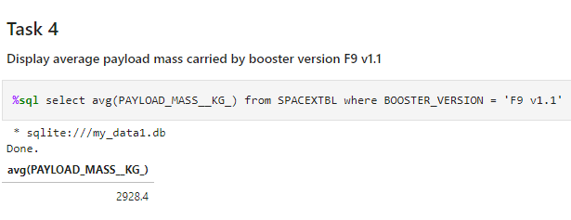
Average Payload Mass by F9 v1.1
Calculated average payload mass carried by booster version F9 v1.1

Slide 28
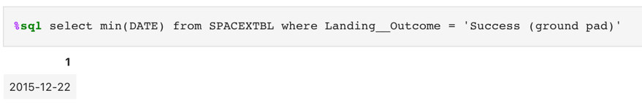
First Successful Ground Landing Date
First successful landing outcome on ground pad

Slide 29
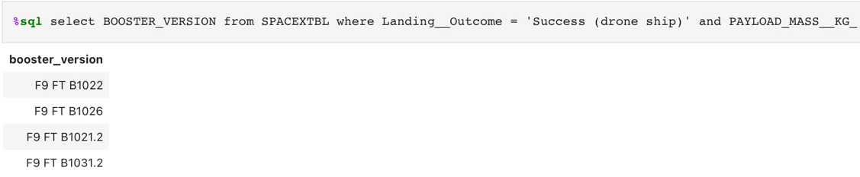
Successful Drone Ship Landing with Payload between 4000 and 6000
Names of boosters which have successfully landed on drone ship and had payload mass greater than 4000 but less than 6000

Slide 30
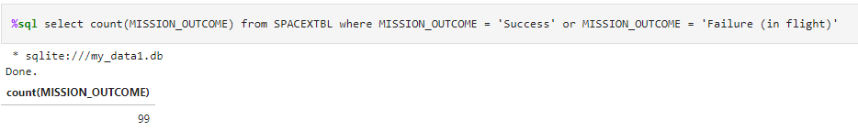
Total Number of Successful and Failure Mission Outcomes
Calculated total number of successful and failure mission outcomes

Slide 31
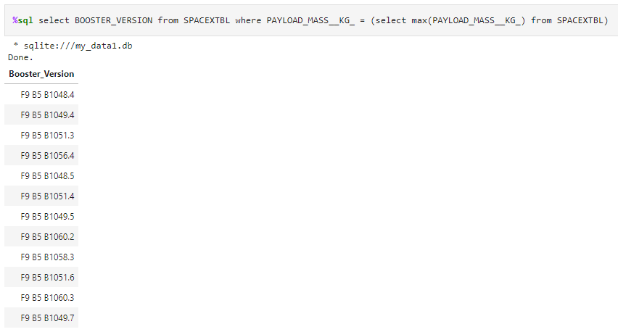
Boosters Carried Maximum Payload
Names of the booster which have carried the maximum payload mass

Slide 32
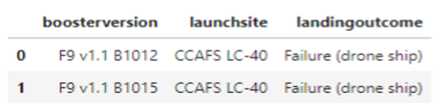
2015 Launch Records
Failed landing outcomes on drone ship, their booster versions, and launch site names for in year 2015

Slide 33
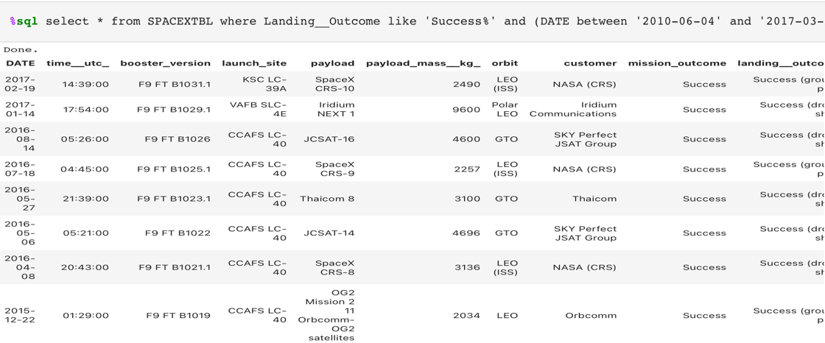
Rank Landing Outcomes Between 2010-06-04 and 2017-03-20
Ranked count of landing outcomes (such as Failure (drone ship) or Success (ground pad)) between the date 2010-06-04 and 2017-03-20, in descending order

Slide 34

Section 3

Slide 35
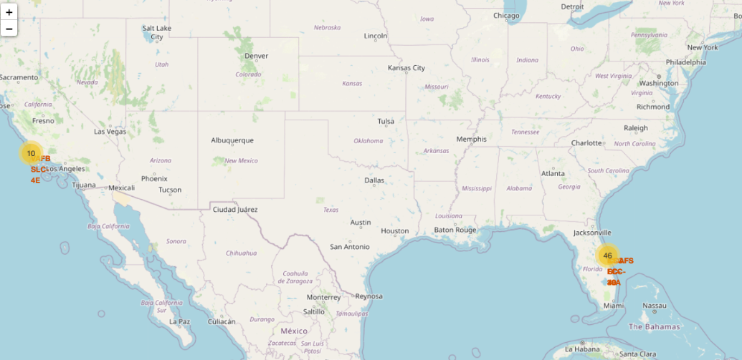
<Folium Map Screenshot 1>
This map shows the different site location across the US in both Florida and California

Slide 36
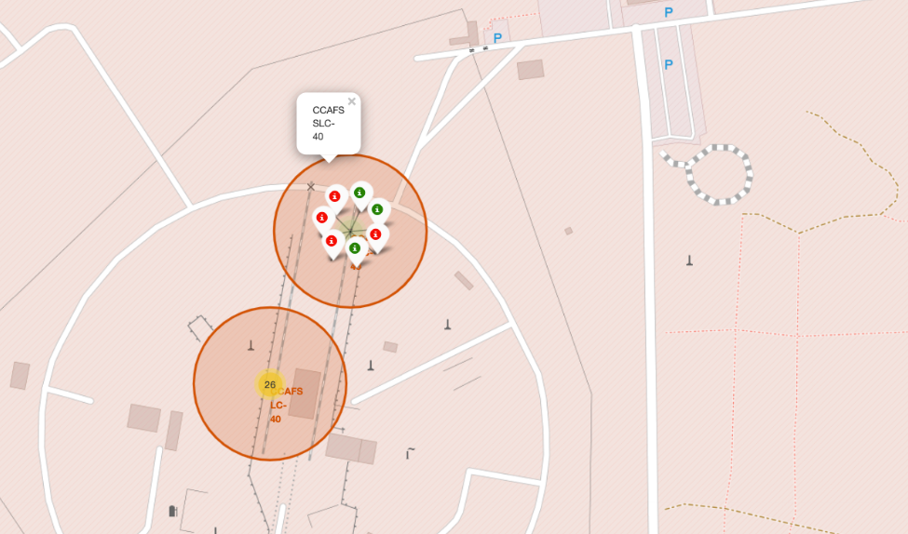
<Folium Map Screenshot 2>
This represents successful and failed landing missions
Failed being in red and successful in green.

Slide 37
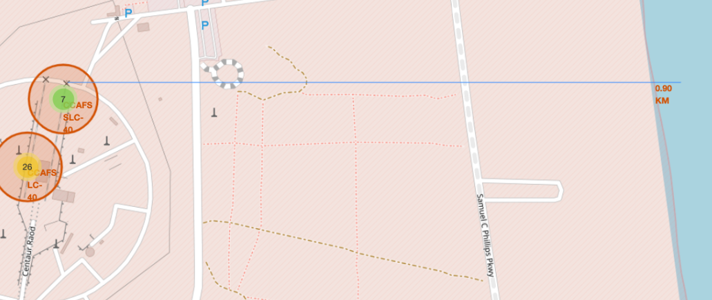
<Folium Map Screenshot 3>
This site map shows map elements relative to the site with respected identifiers like roadways and coast lines.

Slide 38

Section 4

Slide 39
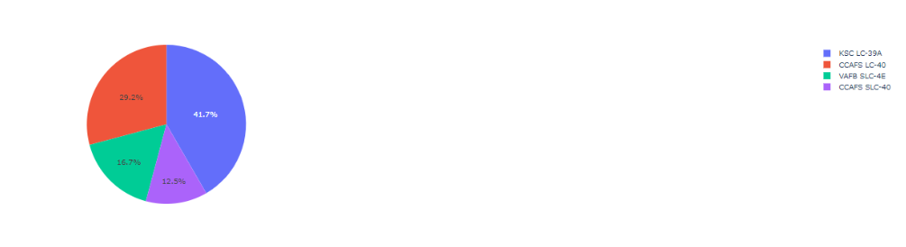
All four sites launch success
This pie chart represent the success of the following sites:
KSC LC-39A
CCAFS LC-40
VAFB SLC-4E
CCAFS SLC-40

Slide 40
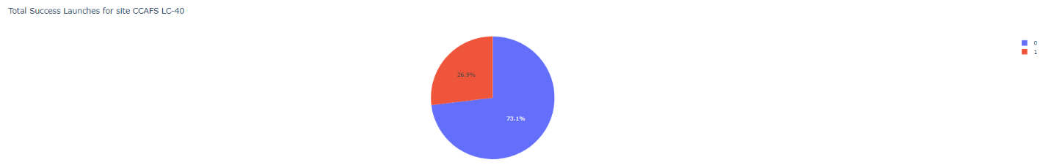
KSC LC 39A Success over other site
This shows the visually represents the success rate of site KSC LC 39A over the three other sits.

Slide 41
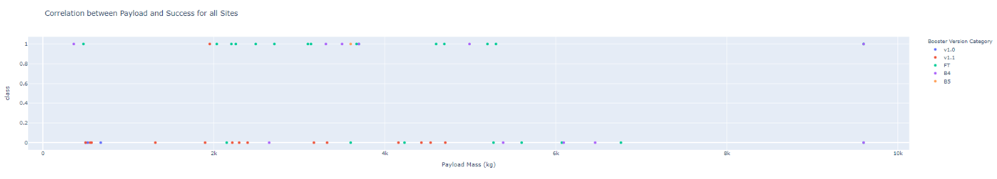
Payload Vs Success
Shown below is the correlation between Payload vs. Launch Outcome
1 for successful outcome and 0 for non-successful
As we can see payload mass above 6kg have not had success and the most successful payload weight in kg is 3kg

Slide 42

Section 5

Slide 43
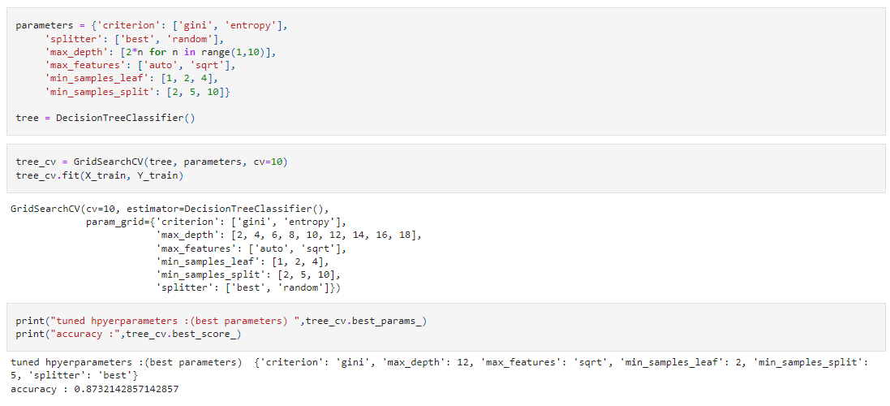
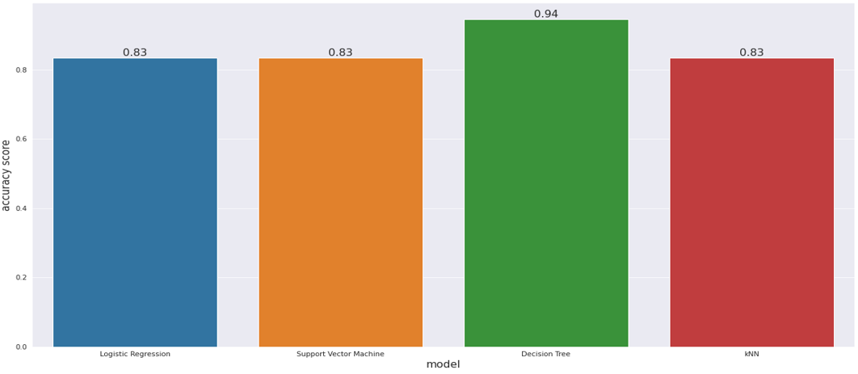
Classification Accuracy
This chart visualizes the built model accuracy for all built classification models, in a bar chart

Slide 44
Confusion Matrix
This shows a confusing matrix predicting a decision tree method with moderate accuracy.

Slide 45

Conclusions
SpaceX is a company that has revolutionized space travel and exploration by introducing reusable rockets. However, in their early days, the company faced many challenges, and many of their launches failed to land and be reused. But over time, they worked hard and made significant progress, achieving higher success rates and reducing the cost of space exploration.
One of the key factors in SpaceX's success is their ability to land and reuse rockets. By doing so, they can significantly reduce the cost of launching a satellite or conducting a space mission. After their 20th flight, SpaceX managed to achieve a much higher success rate of around 83%, indicating that their efforts were paying off.
The success rate varies across different orbits, and some orbits are more challenging than others. For example, the Geostationary Transfer Orbit (GTO) is known to be one of the most challenging orbits for SpaceX. This is because it requires a lot of energy to reach the correct altitude and velocity, and it is difficult to land the rocket back on Earth due to the high speeds involved.
Certain orbits have been particularly successful for SpaceX. For example, the Earth-Sun Lagrange Point 1 (ES-l1), Geostationary Orbit (GEO), High Earth Orbit (HEO), and Sun-Synchronous Orbit (SSO) have all had high success rates. Additionally, the Very Low Earth Orbit (VLEO) has been a primary focus of recent flights, with a success rate of 85% over 13 flights.
Among the launch sites, KSC LC-39A has had the most successful launches. This site has been used for missions to the International Space Station (ISS) and for launching communications satellites.
Finally, machine learning algorithms can be used to predict the outcome of a launch based on various parameters such as launch site, payload, and orbit. The Decision Tree Classifier was found to be the best model to predict the outcome of a flight based on the available data. By using machine learning, SpaceX can optimize their launch processes and improve their success rate even further.

Slide 46


